Slide 1

Presented by:
MD. ABDUL KAIYUM (201002334)
Dept.of CSE
Green University of Bangladesh

Slide 2


GUB Portal A Database system project
Presented by:
MD. ABDUL KAIYUM (201002334)
Dept.of CSE
Green University of Bangladesh

Slide 3

Content Outline
Introduction
01
Detail intro about the project.
Implementation Steps
02
Steps that how the project implemented.
How the Project Works
03
Description about the working method of the project.
Benefit & Cones
04
Prose and Cones of the project.

Slide 4
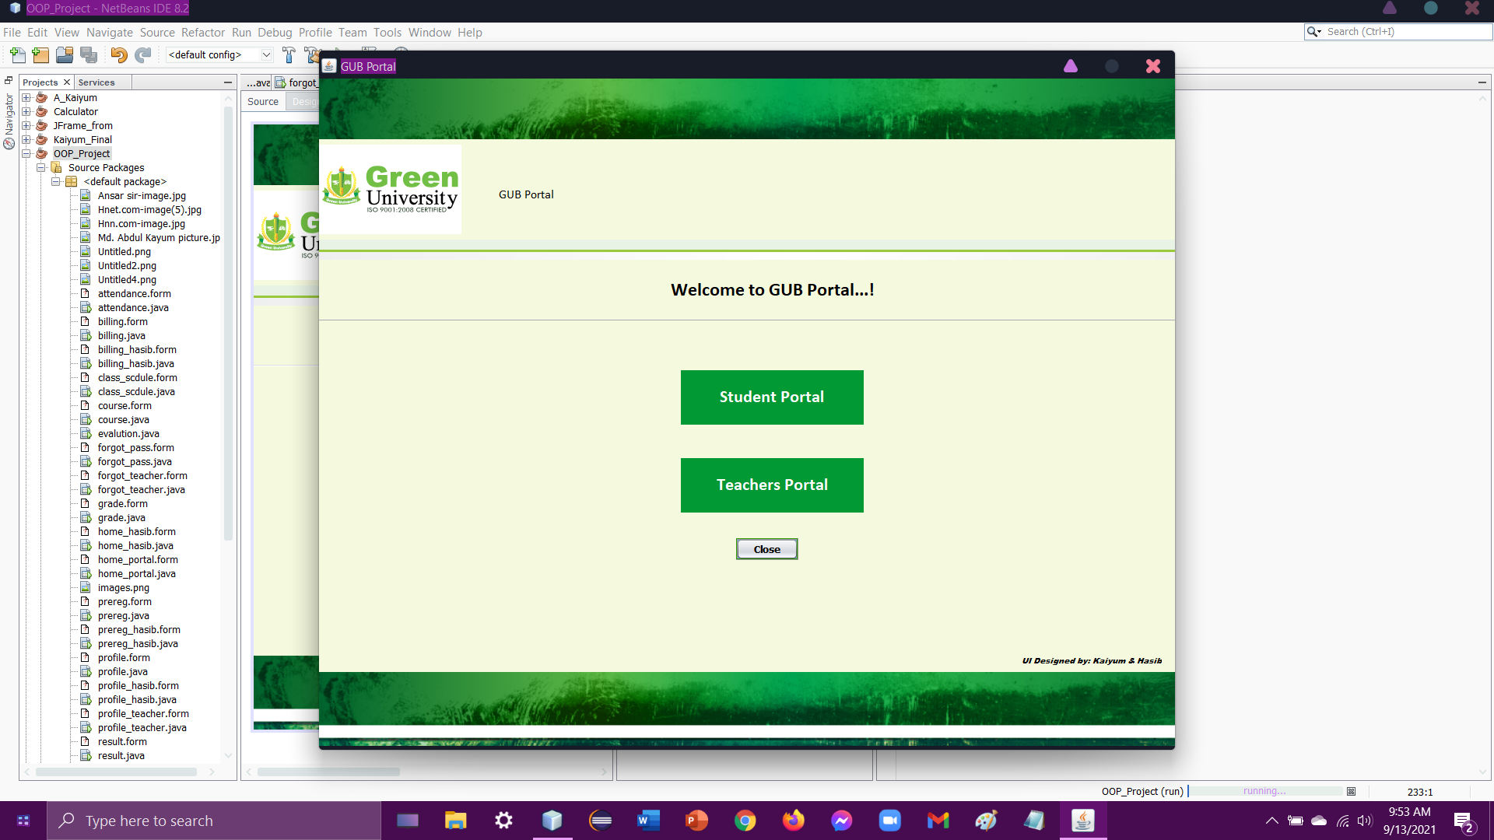
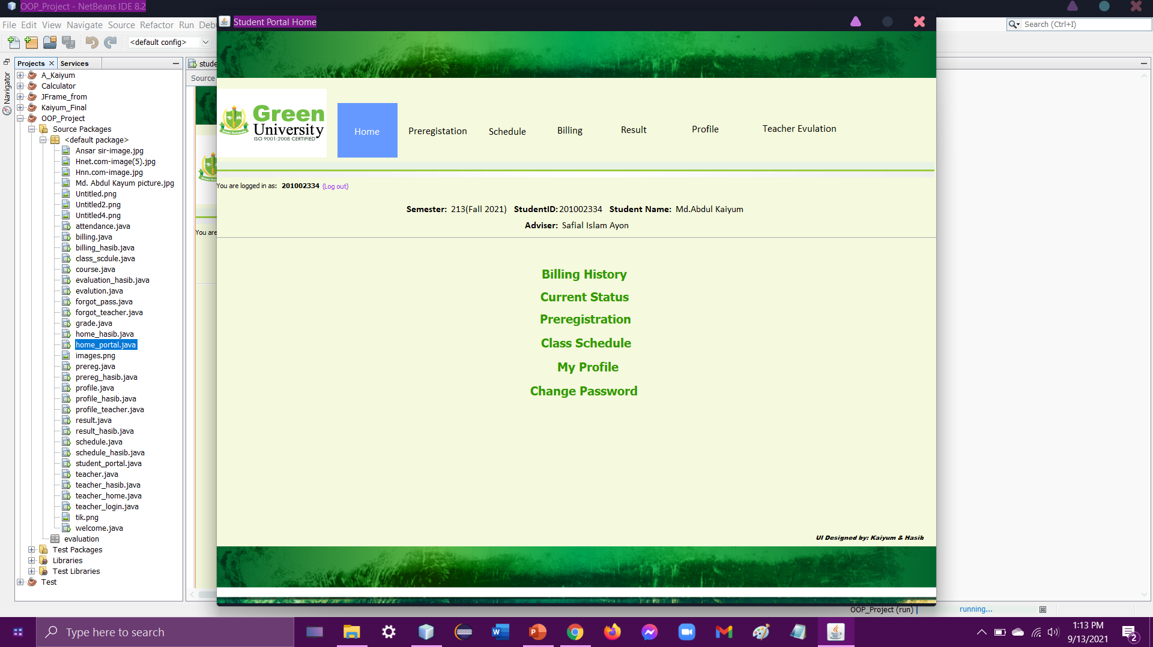

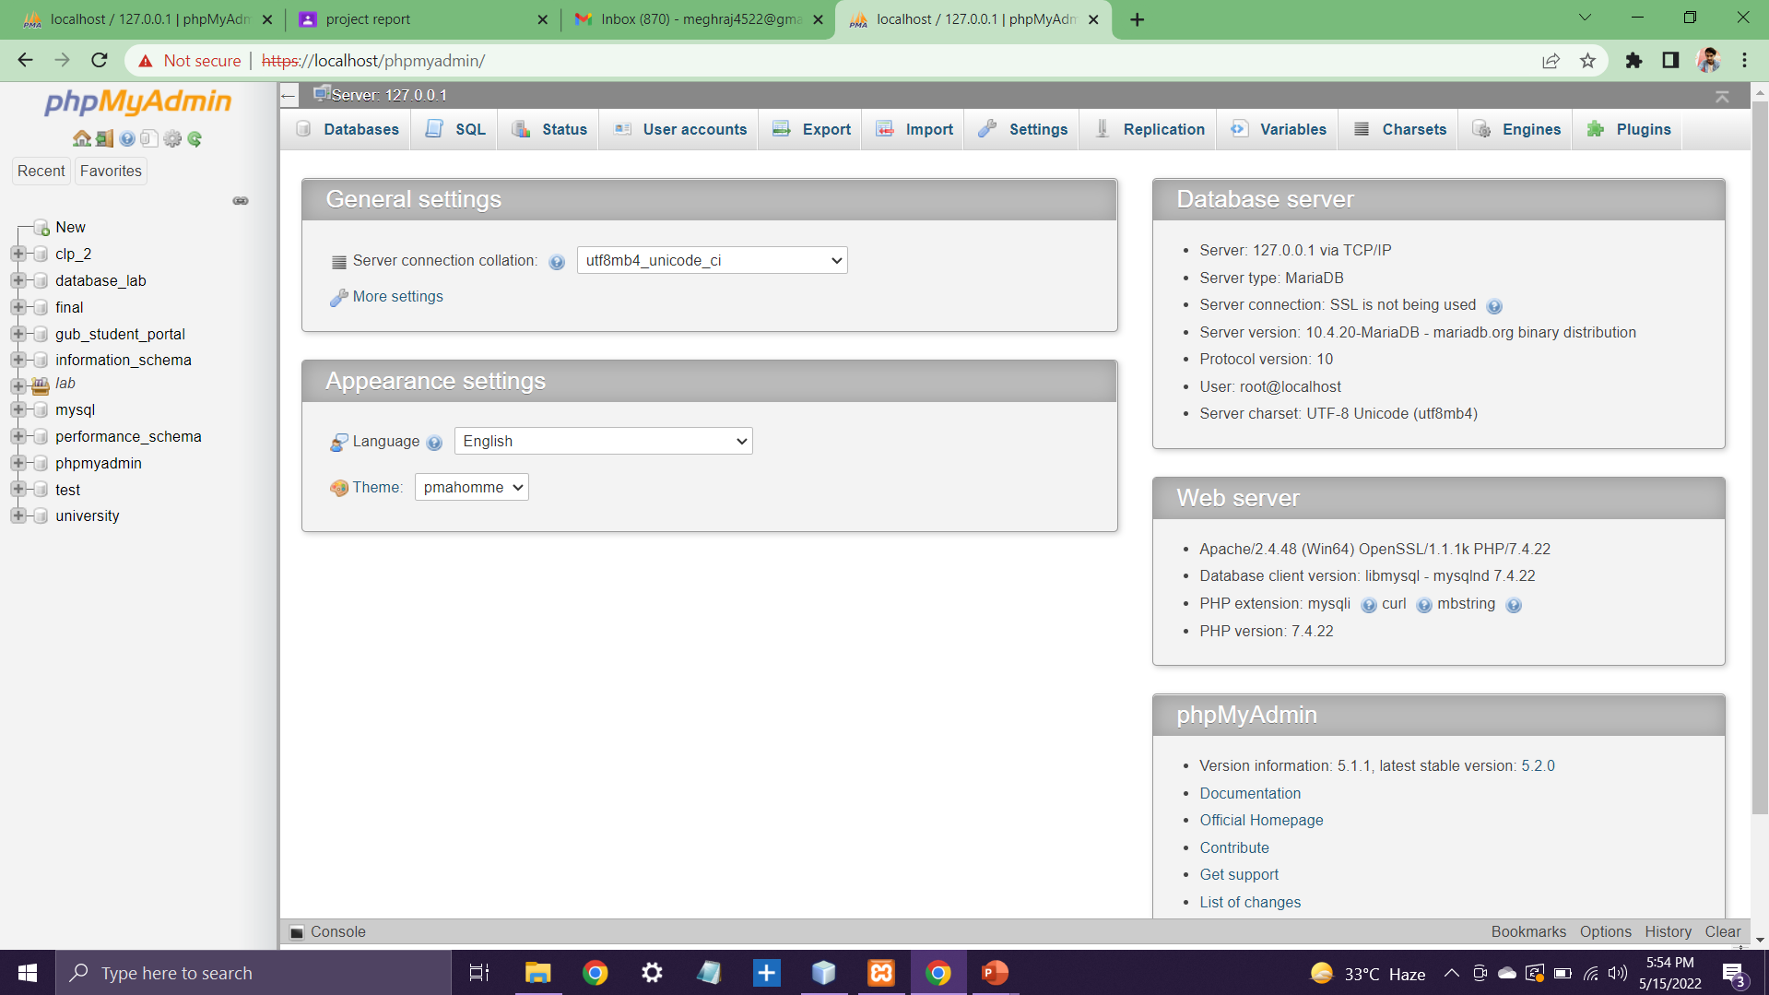
Introduction
The Name of Project is GUB Portal Management System. Where there will be a log in system. After a successful login the user will get access to do their task. And all the task will be academic related.

Slide 5
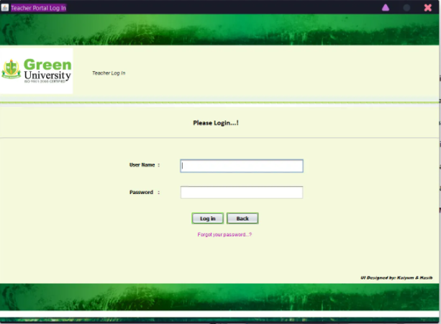
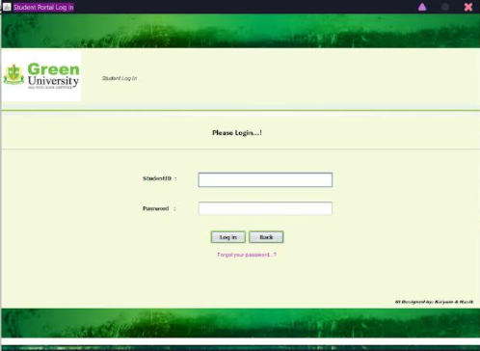

Designing Process
How we made the frame outline
JFrame
Table
Buttons
Password Field
PowerPoint Presentation
Text Field
Database degining

Slide 6

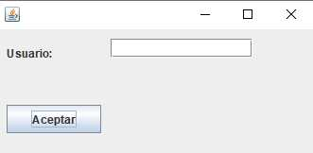
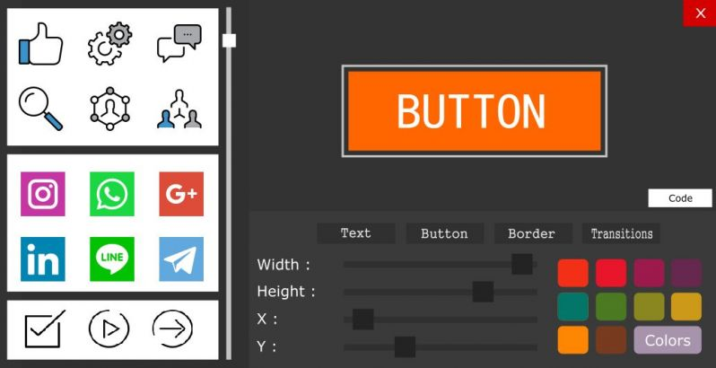
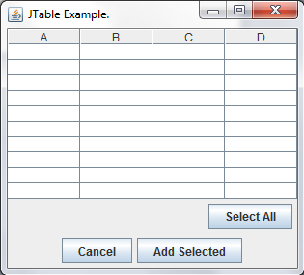
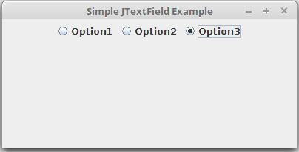
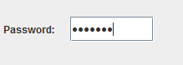
Writing The Code
Set Labels and Variables
Customized the style of the buttons
Set individual sets of codes for each button
Get texts in the text fields

Slide 7
Building The Database
Create Database
Create Table instance
Connect Database with NetBeans
Add & Retrieve Data from Database through NetBeans

Slide 8
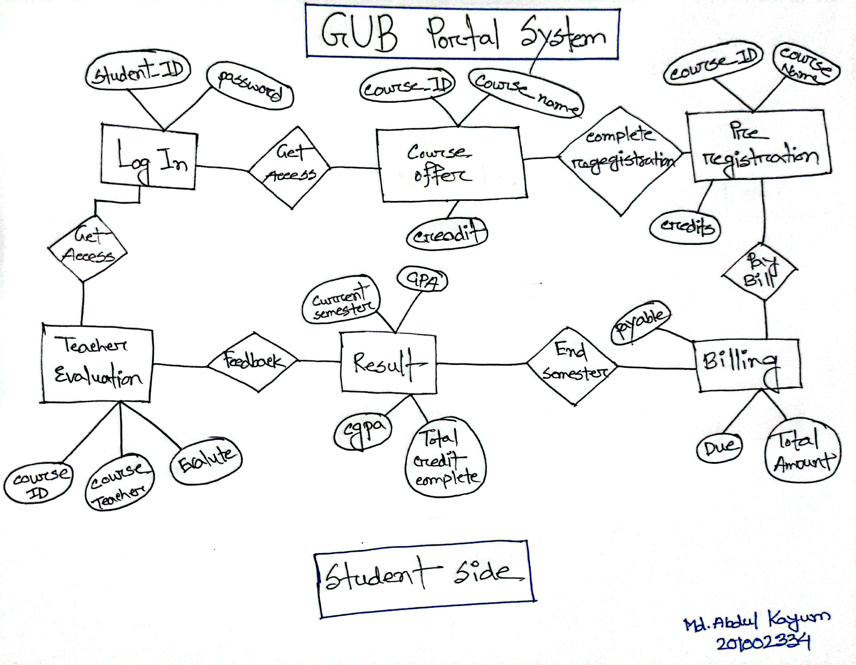
ER Diagram of My Project
How my project works.

Slide 9
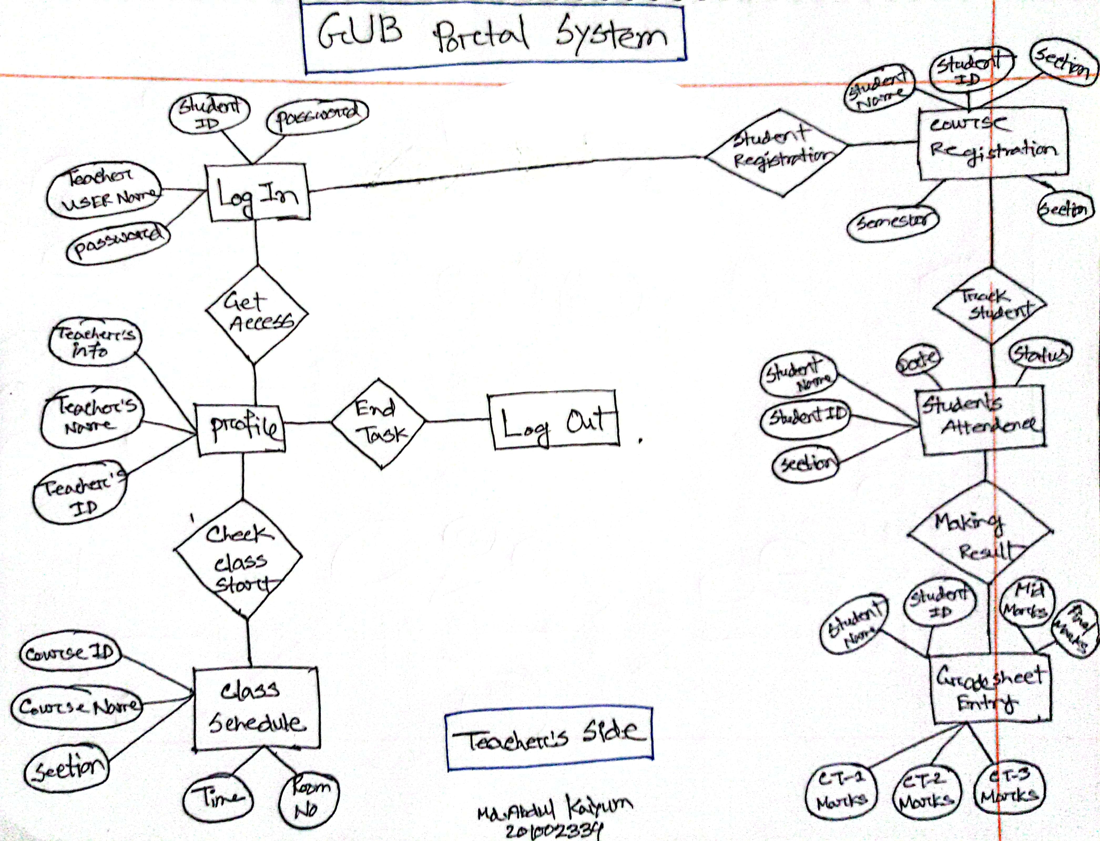
ER Diagram of My Project
How my project works.

Slide 10
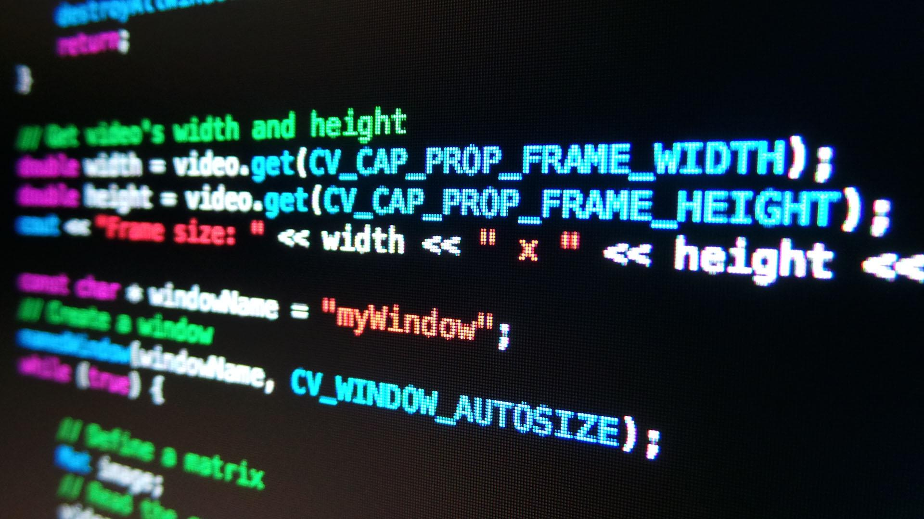
How The Project Works
Matches the credentials
Switches frames
Takes String inputs
Adds data to database(Table)
Retrieve data from database(Table)

Slide 11
Benefits
of My Project
Can be use in any Educational Institute.
Both Student and Teacher can use.
All options are in one place.
Updatable according to our need.
Simple & easy to use.

Slide 12
Cones
of My Project
Single User.
There is some security issues.

Slide 13


Any Question…?

Slide 14


